Slide 1
Computational structure-activity relationship approaches in lead optimization
Yasir Arafat Tamal

Slide 2
Contents
Structure–Activity Relationship (SAR)
SAR Analysis Methods
Quantitative Structure-Activity Relationship (QSAR)
QSAR Methods
Aim of SAR Approaches
Lead Optimization
SAR in Lead Optimization
SAR Principle on Structural Modification

Slide 3
Structure–Activity Relationship (SAR)
The relationship between the chemical or 3D structure of a molecule and its biological activity
Enables the determination of the chemical groups responsible for evoking a target biological effect in the organism
The interaction of the drug molecule with a protein depends on its chemical structure

Slide 4
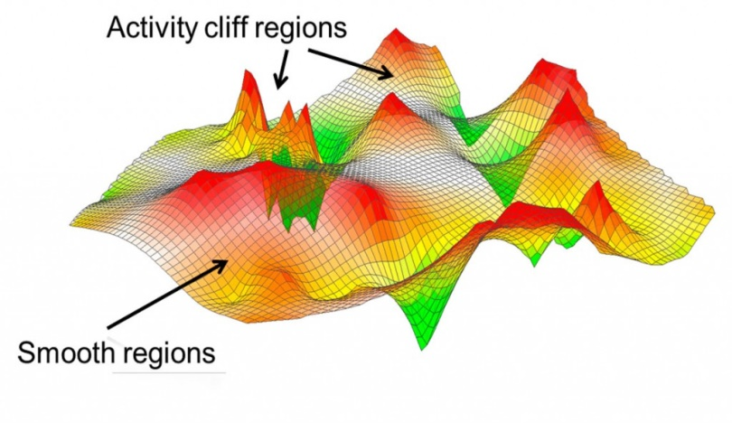
SAR Analysis Methods
Numerical SAR analysis functions:
To quantify SAR information content of data sets
Activity landscapes:
Graphical representation of SAR information
http://www.int.laborundmore.com/archive/281210/Data-Visualization-in-Medicinal-Chemistry.html

Slide 5
Quantitative Structure-Activity Relationship (QSAR)
QSARs are mathematical relationships linking chemical structure and pharmacological activity in a quantitative manner for a series of compounds
When physicochemical properties or structures are expressed by numbers, one can find a mathematical relationship, or quantitative structure-activity relationship, between the two

Slide 6
QSAR Methods
QSAR modelling process consist of 5 main steps
Molecular structure
Molecular descriptors
Building the QSAR model
Model validation
Applicability domain of QSAR

Slide 7
Aim of SAR Approaches
SAR analysis try to convert structure-activity observations into informative structure activity relationships
Initial lead
SAR
Knowledge
Optimized lead
Clinical development

Slide 8
Lead Optimization
Synthesis of analog series
Testing the series to correlate changes in chemical structure to biological and pharmacological data to establish structure-activity relationships (SARs):
Potency
Bioavailability
Stability
Selectivity

Slide 9
SAR in Lead Optimization
Combinatorial chemistry
High throughput screening (HTS)
Microarray and
Protein array
These highly automated technologies have quite literally revolutionized the drug discovery
SAR methods have become increasingly essential as tools for organizing, mining, and interpreting these data from these aforementioned technologies, to guide further experimentation and discovery

Slide 10
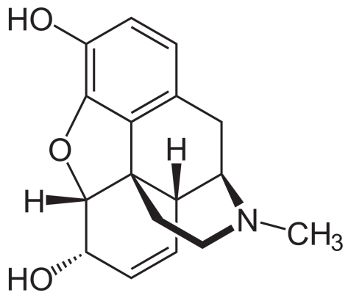
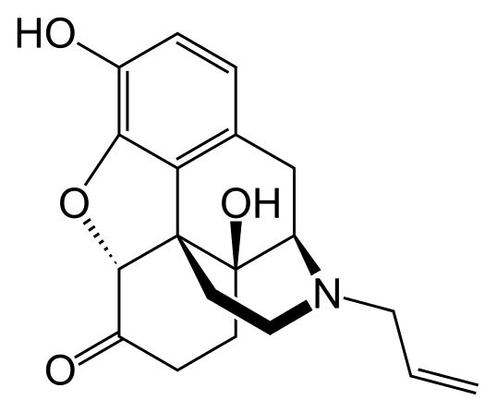
SAR Principle on Structural Modification
Alteration of the molecular structure of an active substance
Testing structural variation effects on biological activities by removing, adding or replacing molecular fragments
Introduction of OH increases activity
N-CH2CH=CH2 creates antagonist
Oxidation increase activity
Morphine
Naloxone
http://opiophilia.blogspot.de/2012/12/opiate-structure-activity-relationship.html

Slide 11
Conclusion
SAR deals with the influence of the functional groups present in the drug on its biological activity
SAR studies are done to determine the pattern of this influence which is employed in the drug design and in the synthesis of many drugs of desired pharmacological activity

Slide 12
References
http://www.oecd.org/chemicalsafety/risk-assessment/introductiontoquantitativestructureactivityrelationships.htm
http://crdd.osdd.net/lopt.php
Tong, Weida, et al. "Structure‐activity relationship approaches and applications." Environmental toxicology and chemistry 22.8 (2003): 1680-1695.
Ceyda Oksel, Xue Z. Wang: http://www.qualitynano.eu/uploads/School2013/TrainingMaterials/7.QSARs-Lecture_CeydaOksel.pdf
Bajorath, Jürgen. "Large-scale SAR analysis." Drug Discovery Today: Technologies 10.3 (2013): e419-e426.

Slide 13
THANK YOU

